Slide 1

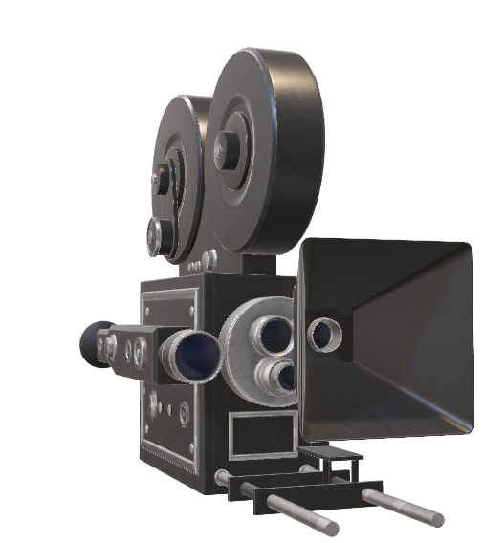
THE MOVIE PLUG
For All Your Movie Needs
Presented by: Chris Guzman, Jowensky Neard, and Julius Conaway

Slide 2
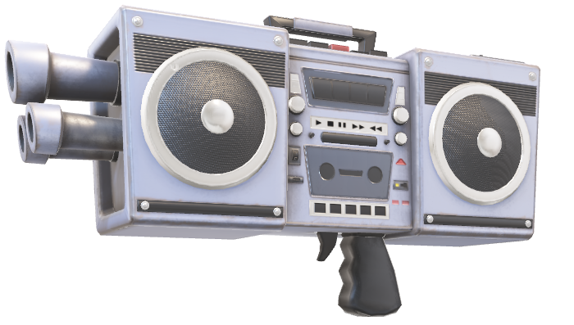
OVERALL CONCEPT
We wanted to create an application that provided the client with an in depth description of a movie.
In doing that we wanted to be sure it included a detailed written description.
We also wanted it to include a few visual descriptions that could display the written plot of the movie.

Slide 3
OUR MOTIVATION
We were motivated by those instances when a person is stuck trying to explain a movie to someone else and the person is having a difficult time remembering the movie in question.
Also settling those age old arguments of “ which actor plays in which movie or when a movie was in theatres”.
A movie search application that uses two separate API’s to provide facts and movie trailers.

Slide 4
Design Process
We decided to keep the application both useful for college students yet extremely easy in hopes to reach more people.
Meet coding requirements by utilizing two API’s both using AJAX calls to pull information from the web.
Also having User Input Validation.

Slide 5
Technologies Used
Used an API to pull three movie trailers from the web(YouTube).
We used another API to pull movie details using the web(OMDB).

Slide 6
How Technologies Were Used
We used materialize first and foremost for our new technology. We used the basic materialize parallax layout with a few adjustments. We used the layout to take advantage of their “icon block” style to display the details of the movie side by side with the movie trailers providing by the you tube API. With you tube providing the top 3 movie trailers available for the movie searched we then used OMDB to get the details available for that movie.

Slide 7
Conclusion
We will now open the floor for any questions and answers.

